Slide 1

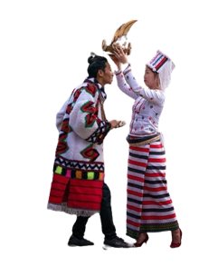
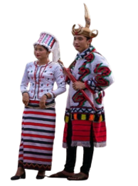
Hybrid Approach to Rawang Language Word Segmentation
Using Part-of-Speech Tagging
Supervised by
First Seminar
Presented by
Dr. Naw Thiri Wai Khin
21.6.2024
Mg Mabu Phong(6IST-21)

Slide 2
Outline
Abstract
Objective
Motivation
Introduction
Basic NLP Analysis Pipeline
Rawang
Rawang Writing System
Scope of Thesis
Background Theory
Example Calculation
Expected Output
Rawang POS Tag Sets
Conclusion and Future Work

Slide 3
Abstract
Natural Language Processing, or NLP, is a field that teaches computers to understand human language.
NLP aims to achieve powerful tasks such as machine translation, text summarization, and information retrieval and so on.
To enhance accuracy in these areas, foundational NLP processes are essential.
The proposed system targets Rawang word segmentation and Part-Of-Speech (POS) tagging, representing foundational processes in NLP.
Word segmentation is achieved using the Maximum Matching Algorithm using Rawang words corpus.
POS tagging is implemented through Conditional Random Fields model using metrics, refining as needed.
1

Slide 4
Objective
To preserve Rawang language representing our preserved culture
To develop a diverse Rawang language corpus
To perform word segmentation using Maximum matching algorithm
To design a tailored CRF model for precise Rawang POS tagging
2

Slide 5
Motivation
Lack of resources for NLP
Increasing popularity of NLP
Dataset availability
Community Encouragement
3

Slide 6
Introduction
Artificial Intelligence (AI) has become more powerful due to the massive surge in digital data from the early 2010s onwards.
AI learns from vast amount of information using algorithms.
NLP is a branch of Artificial Intelligence (AI).
Words are the fundamental building blocks of any language. They are combined to form larger units of text, like sentences and paragraphs.
Before moving on to more complex NLP tasks, NLP foundational analysis on words must be performed.
4

Slide 7
Basic NLP Analysis Pipeline
1
Word Segmentation
2
Part-of-Speech Tagging (POS)

Slide 8
Basic NLP Analysis Pipeline
1
Word Segmentation
2
Part-of-Speech Tagging (POS)
3
Named Entity Recognition (NER)
5

Slide 9
Basic NLP Analysis Pipeline
1
Word Segmentation
2
Part-of-Speech Tagging (POS)
3
Named Entity Recognition (NER)
4
Lexical (or) Morphology
5

Slide 10
Basic NLP Analysis Pipeline
1
Word Segmentation
2
Part-of-Speech Tagging (POS)
3
Named Entity Recognition (NER)
4
Lexical (or) Morphology
5
Stemming (or) Lemmatization
5

Slide 11
Basic NLP Analysis Pipeline
1
Word Segmentation
2
Part-of-Speech Tagging (POS)
3
Named Entity Recognition (NER)
4
Lexical (or) Morphology
5
Stemming (or) Lemmatization
6
Sentiment
5

Slide 12
Basic NLP Analysis Pipeline
1
Word Segmentation
2
Part-of-Speech Tagging (POS)
3
Named Entity Recognition (NER)
4
Lexical (or) Morphology
5
Stemming (or) Lemmatization
6
Sentiment
7
Other
5

Slide 13
Basic NLP Analysis Pipeline
1
Word Segmentation
2
Part-of-Speech Tagging (POS)
3
Named Entity Recognition (NER)
4
Lexical (or) Morphology
5
Stemming (or) Lemmatization
6
Sentiment
7
Other
5

Slide 14
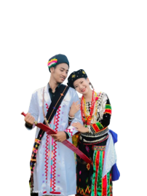
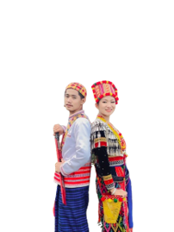
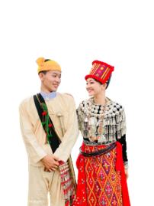
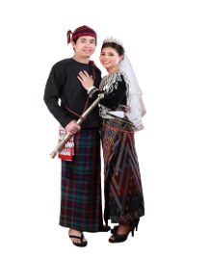
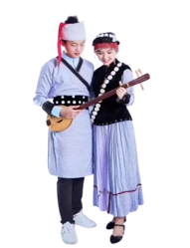
The Six Kachin Ethnic Groups
Jingpaw
Lisu
Rawang
Lachik
Lungwo
Zaiwa
6

Slide 15
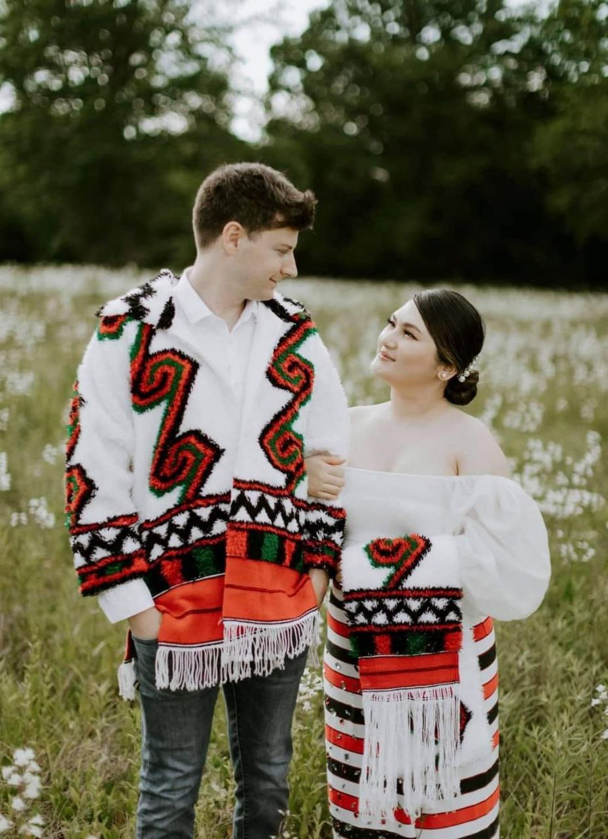
Rawang
Ethnicity code – 109
Spoken by approximately 100,000 Rawang people
Predominantly residing in the Kachin state
Across various regions of Myanmar and have also established communities in foreign countries
The Rawang writing system was initiated in 1940
7

Slide 16

Rawang Writing System (Cont’d)
There are 22 consonants and 7 vowels in Rawang Language
Consonants
Vowels
g k q h ng
j ch sh y r
d t s z n
b p l w m
c ny
I E A
V U ø
O
Diacritics : á ā à aq
8

Slide 17
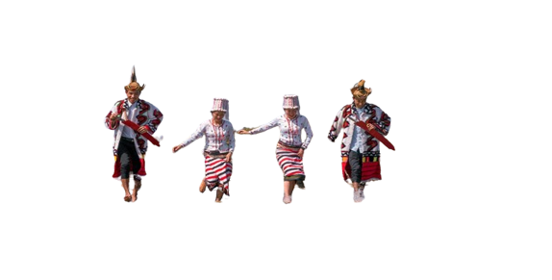
Rawang Sample Text (Cont’d)
Kagabu Razi - ခါကာဘိုရာဇီ
gī -ခွေး
mí - ကြောင်
lègā - စာအုပ်
Pàmvràé - မင်္ဂလာပါ
Àng bø̀ng nø MgMg íe. ( သူသည်မောင်မောင်ဖြစ်သည် )
1
Rawang word corpus and POS tag corpus creation
Word Segmentation with Maximum Matching Algorithm
2
3
Training POS tag corpus with Conditional Random Field
Creating Graphical User Interface for predicting input sentence
4
9
2

Slide 18
Scope of Thesis
1
Rawang word corpus and POS tag corpus creation
Word Segmentation with Maximum Matching Algorithm
2
3
Training POS tag corpus with Conditional Random Field
Creating Graphical User Interface for predicting input sentence
4
10
2

Slide 19
Background Theory
Word segmentation or tokenization is a process of dividing a continuous text into separate words or tokens.
Word segmentation complexity depends on the nature of each language.
In the Rawang language, there is an explicit space between individual words or phrases, simplifying the process of word segmentation.
Maximum matching algorithm is popular for limited corpus or dataset.
Notably, the maximum matching algorithm includes forward, backward, and bidirectional matching.
In this proposed system, bidirectional matching is utilized for efficient tokenization.
11

Slide 20
Maximum Matching Algorithm(Bidirectional)
Firstly, split sentence by space obtaining word and phrases before applying this algorithm
Word Corpus
Sentence : “I play tennis youplaybaseball”
I
you
play
tennis
base
ball
baseball
Split with space :
[ I, play, tennis, youplaybaseball ]
Result :
[ I, play, tennis ]
12

Slide 21


Maximum Matching Algorithm (Cont’d)
Firstly, split sentence by space obtaining word and phrases before applying this algorithm.
Then, phrases are splitted by Maximum Matching Algorithm.
Word Corpus
Maximum Matching
I
you
play
tennis
base
ball
baseball
Phrase : [ youplaybaseball ]
[ you, play, base, ball ]
[ you, play, baseball ]
Result :
[ I, play, tennis, you, play, baseball ]
13

Slide 22
Example Calculation
Word Corpus
Pharase = dètánø̀ng (dè tá nø̀ng)
Forward = dè tán ø̀ng
Backward = dè tá nø̀ng
Comparing the length of forward and backward (Bidirectional),
dè tá nø̀ng (Backward)
dè
tá
tán
nø̀ng
ø̀ng
14

Slide 23
System Design
start
Input Rawang text
Sentence Segmentation
Word Segmentation
Maximum Matching Algorithm
Word Corpus
POS Tagging
CRF Model
Labeled Corpus
Display words with tags
End
15

Slide 24
Expected Output
OUTPUT
Input sentence : Yesukristu shøqyanga dang nø íe.
Segmented Words : Yesu kristu shøq yanga dang nø í e .
Pos Tags : noun noun verb adj noun adp verb chro .
16

Slide 25
Rawang POS Tag Sets
Noun (N)
Nouns (NN)
Pronoun (PN)
Verb (V)
Preposition (PREP)
Adjective (ADJ)
Adverb (ADV)
Conjunction (CONJ)
Foreign Word (FW)
Symbol (SB)
Particle (PRT)
Interrogative (IR)
Number (NUM)
Number Text (NT)
Chronological Verb (CV)
Case(C)
Demonstrator (DM)
Locative (LOC)
17

Slide 26
Conclusion
Tokenization is a crucial step before POS tagging because POS tagging relies on the individual tokens to assign the correct grammatical category.
POS tagging is commonly performed after word segmentation or tokenization.
Precise foundational analysis in NLP enhances advanced tasks such as machine translation, summarization, information extraction, and more.
18

Slide 27
Future Work
Thank you
Rawang Word Corpus creation
Labeled Corpus creation
Testing Word Segmentation
Training labeled corpus with CRF Model
Linking Word Segmentation and Part-of-Speech Tagging
Building Graphical User Interface
19

Slide 28
Thank you

